Slide 1
Topic : C++
Name : Komal Mangchwari
Section : “A”
Course: BCA

Slide 2
Topics cover :
History of c++
Compilation process in c
Advantages of c++
Why c++ is better than c
Basic program in c++
Variable and Keyword in c++
Conditional statement
Loops
Functions
Switch case
Pointer
Array

Slide 3
HISTORY OF C++
In the early 1970’s Dennis Ritchie of bell Laboratories was engaged in a project to develop a new operating system . Ritchie discovered that in order to accomplish his task he needed the use of a programming language that was concise and that produced compact and speedy programs.
This need led Ritchie to develop the programming language called c language.
In the early 1980’s at Bell Laboratories another programming language was created which was based on c that is c++.

Slide 4
compilation process in c++
Source code
C++ preprocessor
Temporary variable

Slide 5
Compiler
Assembly Code
Assembler
Object code
Linker
Executable File

Slide 6
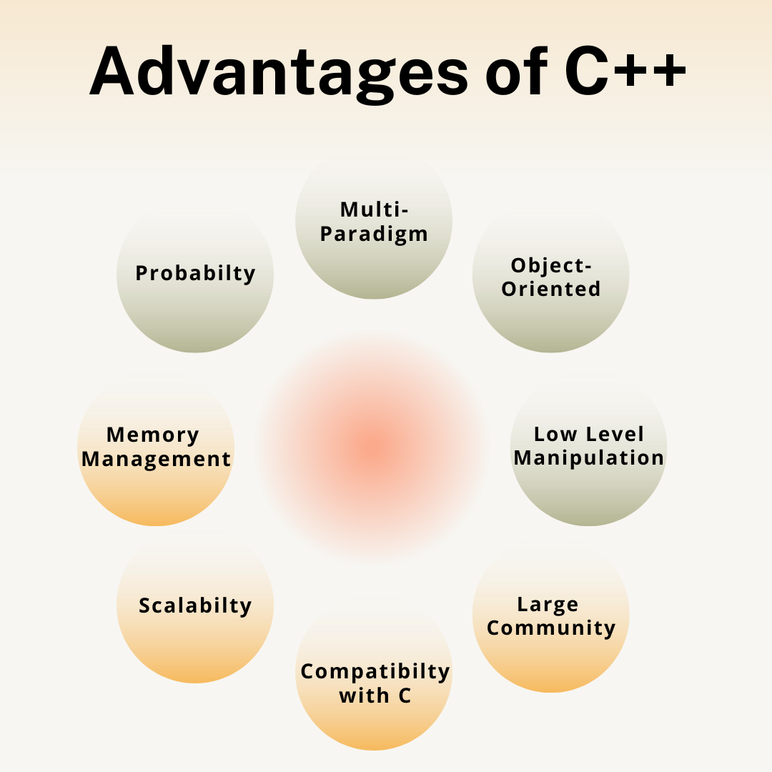

Slide 7
Why c++ is better than c ?

Slide 8
*Object-Oriented Programming (OOP):
Support for classes and objects.
2. *Standard Template Library (STL):
Rich template classes and functions.
3. *Richer Standard Library:
More features like streams, string handling, etc.
4. *Exception Handling:
Structured handling of exceptional situations.
5. *Function Overloading, Operator Overloading:
Code flexibility and
6. *Type Safety and Stronger Type Checking:
Reduced runtime errors.
.8. *Standardized Memory Management:
Alternatives to manual memory management.

Slide 9
Basic program in C++
#include<iostream>
using namespace std;
int main(){
cout<<“hello world”;
}

Slide 10
Use of escape sequence endl and ‘\n’
Example :
cout<<”Hello PW”;
cout<<endl;
cout<<”Hello CW”;
Output will be :
Hello PW
Hello CW

Slide 11
Variable Naming rules
1) Variables can start from an alphabet or underscore _ or $ .
2) Special characters except _ and $ are not allowed.
3) Some particular keywords are not allowed.
4) Commas or blanks are not allowed.
C++ keyword
Auto double int break extern enum unsigned while
case sizeof for const static long continue float
else signed do short switch char volatile default
goto struct if union return void register typedef

Slide 12
Conditionals
if, if – else
Nested
Else if ladder
Ternary
switch

Slide 13
If in C++

Slide 14
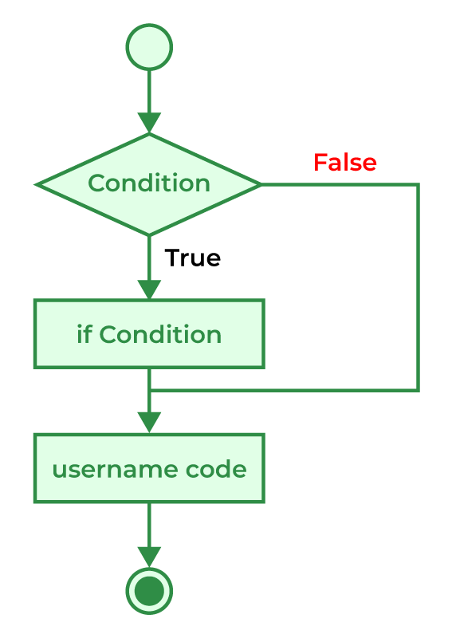
The if statement is the most simple decision-making statement. It is used to decide whether a certain statement or block of statements will be executed or not i.e if a certain condition is true then a block of statements is executed otherwise not.
Syntax of if Statement
if(condition)
{
// Statements to execute if
// condition is true
}

Slide 15
IF - ELSE

Slide 16
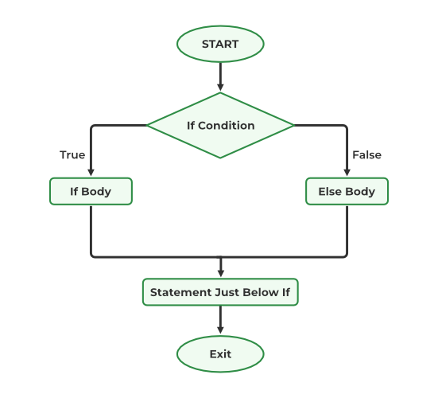
The if statement alone tells us that if a condition is true it will execute a block of statements and if the condition is false it won’t. But what if we want to do something else when the condition is false? Here comes the C else statement. We can use the else statement with the if statement to execute a block of code when the condition is false. The if-else statement consists of two blocks, one for false expression and one for true expression.
Syntax of if else in C/C++
if (condition)
{
// Executes this block if
// condition is true
}
else
{
// Executes this block if
// condition is false
}

Slide 17
Program to check if a person is eligible to vote in C++
#include <iostream>
using namespace std;
int main()
{
int age;
cout<<"\nEnter age";
cin>>age;
if(age >= 18)
cout<<"Eligible for Voting! ";
else
cout<<"Eligible for Voting! ";
return 0;
}
Output:
Enter age17
Eligible for Voting!

Slide 18
Nested if-else in C++

Slide 19
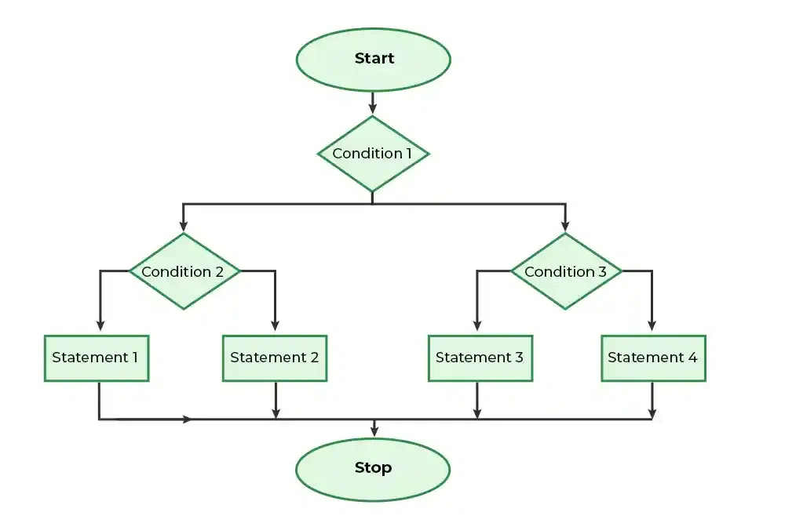
A nested if in C is an if statement that is the target of another if statement. Nested if statements mean an if statement inside another if statement. Yes, both C and C++ allow us to nested if statements within if statements, i.e, we can place an if statement inside another if statement.
Syntax of Nested if-else
if (condition1)
{
// Executes when condition1 is true
if (condition2)
{
// Executes when condition2 is true
}
else
{
// Executes when condition2 is false
}

Slide 20
WAP a cpp to check whether the given no is equal to 10 or not .If yes then check that the no is greater than 12 and 15 or NOT ?
#include <iostream>
using namespace std;
int main()
{
int i = 10;
if (i == 10) {
// First if statement
if (i < 15)
cout<<"i is smaller than 15\n";
// Nested - if statement
// Will only be executed if statement above
// is true
if (i < 12)
cout<<"i is smaller than 12 too\n";
else
cout<<"i is greater than 15";
}
return 0;
}
Output
i is smaller than 15
i is smaller than 12 too

Slide 21
if- else-if
Ladder in C++

Slide 22
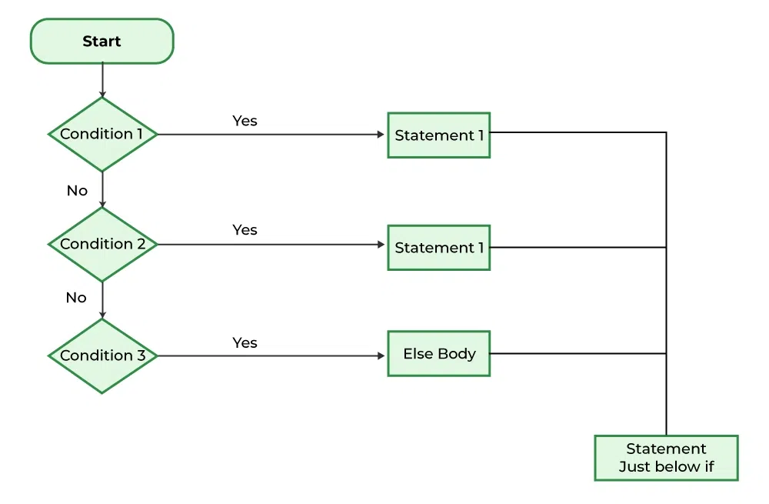
The if else if statements are used when the user has to decide among multiple options. The C if statements are executed from the top down. As soon as one of the conditions controlling the if is true, the statement associated with that if is executed, and the rest of the C else-if ladder is bypassed. If none of the conditions is true, then the final else statement will be executed. if-else-if ladder is similar to the switch statement.
Syntax of if-else-if Ladder
if (condition)
statement;
else if (condition)
statement;
.
.
else
statement;

Slide 23
Write a program to check the given no is equal to 10 or 15 or 20 or NOT ?
// C program to illustrate nested-if statement
#include <iostream>
int main()
{
int i = 20;
if (i == 10)
printf("i is 10");
else if (i == 15)
printf("i is 15");
else if (i == 20)
printf("i is 20");
else
printf("i is not present");
return 0;
}
Output
i is 20

Slide 24
switch Statement
in C++

Slide 25
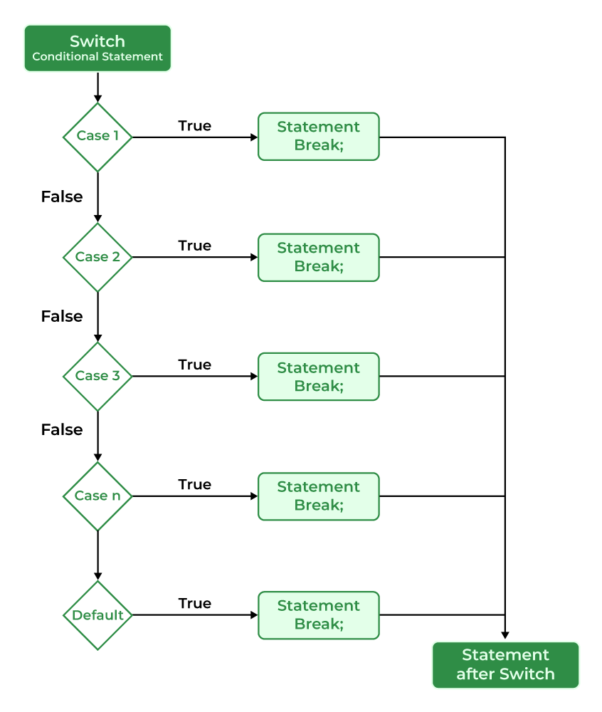
The switch case statement is an alternative to the if else if ladder that can be used to execute the conditional code based on the value of the variable specified in the switch statement. The switch block consists of cases to be executed based on the value of the switch variable.
Syntax of switch
switch (expression) {
case value1:
statements;
case value2:
statements;
....
....
....
default:
statements;
}

Slide 26
WAP to print the greeting :-
Hello
Namaste
Bonjour
#include <iostream>
using namespace std;
int main()
{
// variable to be used in switch statement
int var = 2;
// declaring switch cases
switch (var) {
case 1:
cout<<“hello\n";
break;
case 2:
cout<<“Namaste\n";
break;
case 3:
cout<<“Bonjour \n”;
default:
cout<<“invalid number\n";
break;
}
return 0;
}
Output
Namaste

Slide 27
C++ Loops
In Programming, sometimes there is a need to perform some operation more than once or (say) n number of times. Loops come into use when we need to repeatedly execute a block of statements.
Using Loops
Simple Method without loops
#include <iostream>
using namespace std;
int main()
{
cout << "Hello World\n";
cout << "Hello World\n";
cout << "Hello World\n";
cout << "Hello World\n";
cout << "Hello World\n";
return 0;
}
#include <iostream>
using namespace std;
int main()
{
for (int i = 1; i <= 5; i++) {
cout << "Hello World\n";
}
return 0;
}
Output
Hello World
Hello World
Hello World
Hello World
Hello World

Slide 28
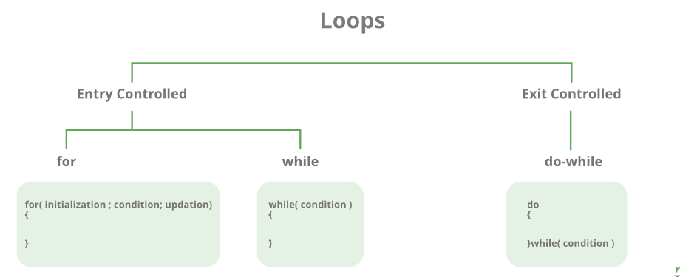
Types of Loops
There are mainly two types of loops:
Entry Controlled loops: In this type of loop, the test condition is tested before entering the loop body. For Loop and While Loop is entry-controlled loops.
Exit Controlled Loops: In this type of loop the test condition is tested or evaluated at the end of the loop body. Therefore, the loop body will execute at least once, irrespective of whether the test condition is true or false. the do-while loop is exit controlled loop.

Slide 29
S.No. | Loop Type and Description
1. | while loop– First checks the condition, then executes the body.
2. | for loop– firstly initializes, then, condition check, execute body, update.
3. | do-while Loop- firstly, execute the body then condition check

Slide 30
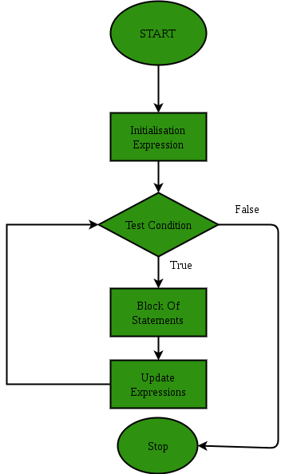
For Loop-
A For loop is a repetition control structure that allows us to write a loop that is executed a specific number of times. The loop enables us to perform n number of steps together in one line.
Syntax:
for (initialization ; condition; updation)
{
// body of the loop
// statements we want to execute
}

Slide 31
Example:
Write a program to print hello world 5 times using for- loop
#include <iostream>
using namespace std;
int main()
{
for (int i = 1; i <= 5; i++) {
cout << "Hello World\n";
}
return 0;
}
Output
Hello World
Hello World
Hello World
Hello World
Hello World

Slide 32
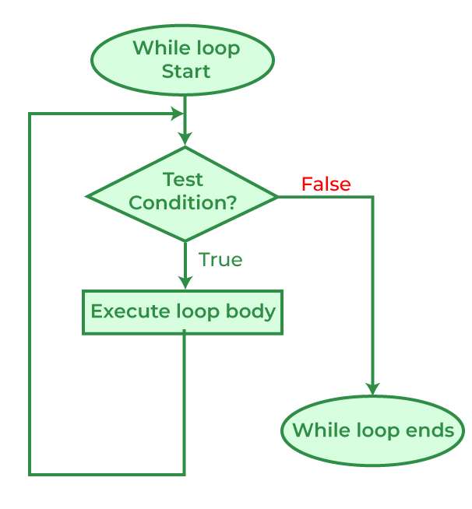
While Loop-
While studying for loop we have seen that the number of iterations is known beforehand, i.e. the number of times the loop body is needed to be executed is known to us. while loops are used in situations where we do not know the exact number of iterations of the loop beforehand.
The loop execution is terminated on the basis of the test conditions. We have already stated that a loop mainly consists of three statements – initialization expression, test expression, and update expression. The syntax of the three loops – For, while, and do while mainly differs in the placement of these three statements.
Syntax of while loop :
initialization expression;
while (test_expression)
{
// statements
update_expression;
}

Slide 33
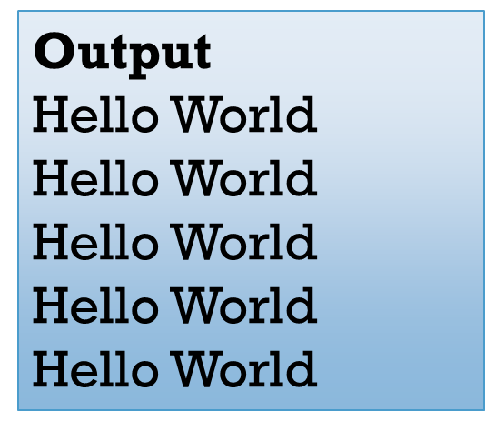
Example:
Write a program to print hello world 5 times using while- loop?
#include <iostream>
using namespace std;
int main()
{
// initialization expression
int i = 1;
// test expression
while (i < 6) {
cout << "Hello World\n";
// update expression
i++;
}
return 0;
}

Slide 34
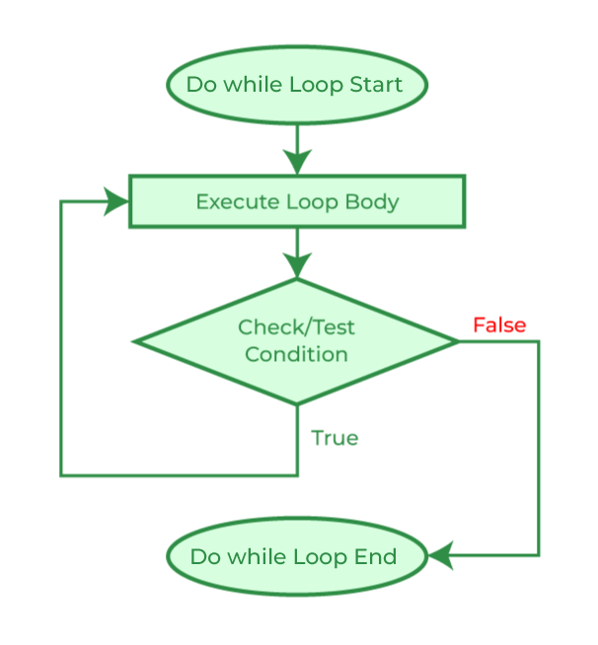
Do-while loop
In Do-while loops also the loop execution is terminated on the basis of test conditions. The main difference between a do-while loop and the while loop is in the do-while loop the condition is tested at the end of the loop body, i.e do-while loop is exit controlled whereas the other two loops are entry-controlled loops.
Note: In a do-while loop, the loop body will execute at least once irrespective of the test condition.
Syntax of do-while loop:
initialization expression;
do
{
// statements
update_expression;
} while (test_expression);
Note: Notice the semi – colon(“;”)in the end of loop.

Slide 35
Example:
Write a program to print hello world 5 times using do-while loop?
#include <iostream>
using namespace std;
int main()
{
int i = 0; // Initialization expression
do {
// loop body
cout << "Hello World\n";
// update expression
i++;
} while (i < 5); // test expression
return 0;
}
Output
Hello World
Hello World
Hello World
Hello World
Hello World

Slide 36
Functions
in C++

Slide 37
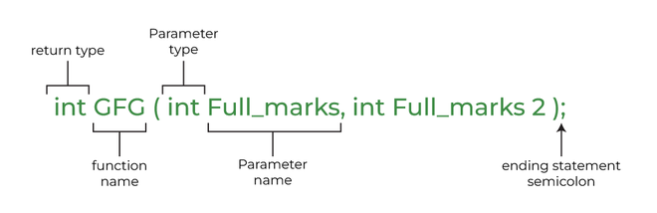
A function is a set of statements that takes input, does some specific computation, and produces output. The idea is to put some commonly or repeatedly done tasks together to make a function so that instead of writing the same code again and again for different inputs, we can call this function. In simple terms, a function is a block of code that runs only when it is called.
Syntax:

Slide 38
Write a cpp program to make a function for comparing two values then printing the maximum no ?
#include <iostream>
using namespace std;
// Following function that takes two parameters 'x' and 'y'
// as input and returns max of two input numbers
int max(int x, int y)
{
if (x > y)
return x;
else
return y;
}
// main function that doesn't receive any parameter and
// returns integer
int main()
{
int a = 10, b = 20;
// Calling above function to find max of 'a' and 'b'
int m = max(a, b);
cout << "m is " << m;
return 0;
}
Output
m is 20

Slide 39
Types of functions
User defined
Library

Slide 40
Write a cpp program to make a square root function?
Also use sqrt() function in your program.
#include <iostream>
#include <cmath>
using namespace std;
double squareRoot(double number){
// sqrt() is a library function to calculate the square root
return sqrt(number);
}
int main() {
double number;
number = 25.0;
cout << "Square root of " << number << " = " << squareRoot(number);
return 0;
}
Output
Square root of 25 = 5

Slide 41
User Defined Function
These functions are part of a compiler package that is already defined and consists of a special function with special and different meanings.
Built-in Function gives us an edge as we can directly use them without defining them whereas in the user-defined function we have to declare and define a function before using them. For Example: sqrt(), setw(), strcat(), etc.
Library Function
Library functions are also called “built-in Functions“.
These functions are part of a compiler package that is already defined and consists of a special function with special and different meanings.
Built-in Function gives us an edge as we can directly use them without defining them whereas in the user-defined function we have to declare and define a function before using them. For Example: sqrt(), setw(), strcat(), etc.

Slide 42
Pointers

Slide 43
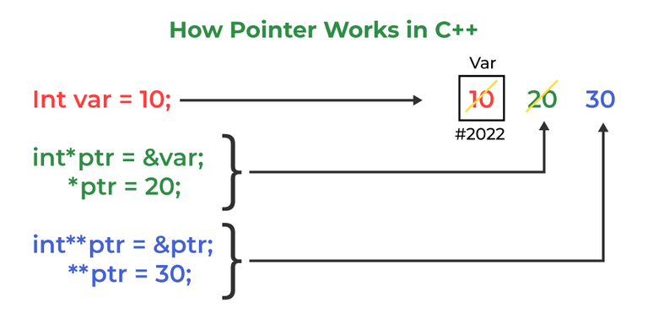
Pointers are symbolic representations of addresses.
They enable programs to simulate call-by-reference as well as to create and manipulate dynamic data structures. Iterating over elements in arrays or other data structures is one of the main use of pointers.
The address of the variable you’re working with is assigned to the pointer variable that points to the same data type (such as an int or string).
Syntax:
datatype *var_name;
int *ptr; // ptr can point to an address which holds int data

Slide 44
Write a cpp program to make a pointer then store some value on it .Then print the address of variable , value of variable and value of variable using pointer?
#include <iostream>
using namespace std;
void geeks()
{
int var = 20;
// declare pointer variable
int* ptr;
// note that data type of ptr and var must be same
ptr = &var;
// assign the address of a variable to a pointer
cout << "Value at ptr = " << ptr << "\n";
cout << "Value at var = " << var << "\n";
cout << "Value at *ptr = " << *ptr << "\n";
}
//main function
int main()
{
geeks();
return 0;
}
Output
Value at ptr = 0x7ffe454c08cc
Value at var = 20
Value at *ptr = 20

Slide 45
What
is
an
Array?

Slide 46
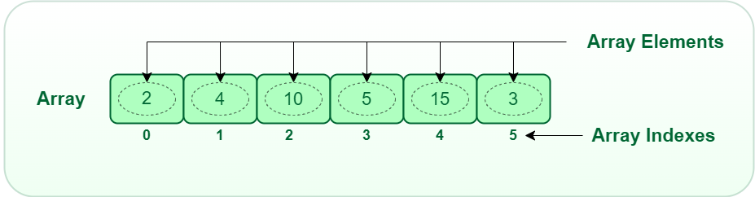
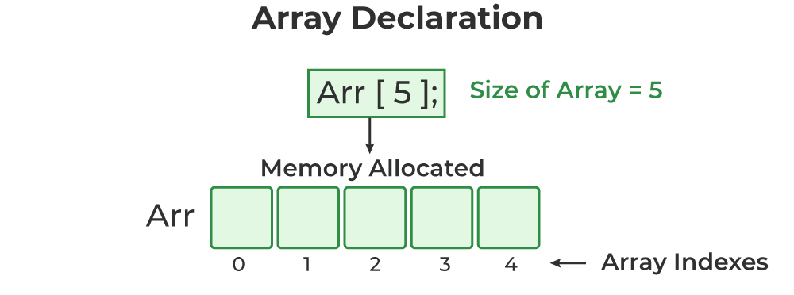
An array is the data structure that can store a fixed size sequence of the element of a same type.
An array is a collection of items of same data type stored at contiguous memory locations.
This makes it easier to calculate the position of each element by simply adding an offset to a base value, i.e., the memory location of the first element of the array (generally denoted by the name of the array).
The base value is index 0 and the difference between the two indexes is the offset.

Slide 47
Types of Arrays
1 Dimensional Array
(1D Array)
Multi - Dimensional Array
2d array
3d Array

Slide 48
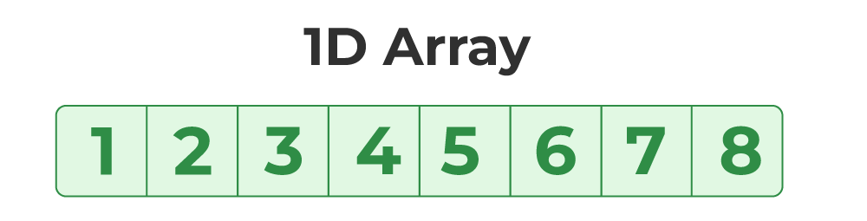
1. One Dimensional Array in C
The One-dimensional arrays, also known as 1-D arrays in C are those arrays that have only one dimension.
Syntax of 1D Array declaration
Data_type array_name [size];
WAP for taking input in 1d array using runtime initialization ?
WAP for printing the values that are stored in 1d array?
int main()
{
int size=5;
int array[size];
for( int i=0;i< size;i++)
{
cin>>array[i];
}
return 0;
}
int main()
{
int array[5]={ 1, 2, 3, 4, 5} ;
for( int i=0;i<size ; i++)
{
cout<<array[i]<<“ “;
}
return 0;
}

Slide 49
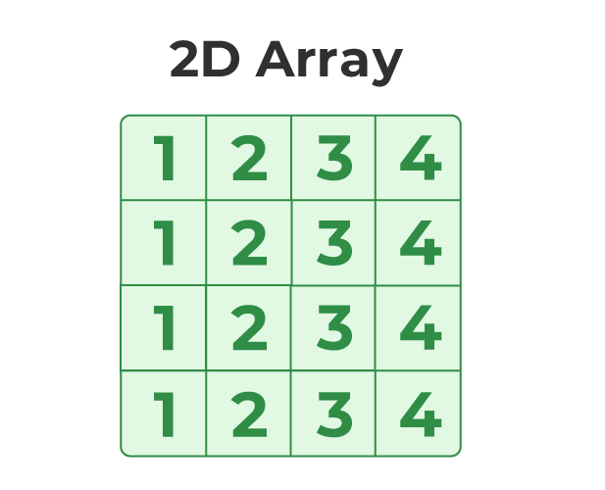
Two-Dimensional Array in C
A Two-Dimensional array or 2D array in C is an array that has exactly two dimensions. They can be visualized in the form of rows and columns organized in a two-dimensional plane.
Syntax of 2D Array in C
Data_type array_name[size1] [size2];
Here,
size1: Size of the first dimension.
size2: Size of the second dimension.

Slide 50
WAP to print the elements of the 2d array ?
#include <iostream>
using namespace std;
int main()
{
// declaring and initializing 2d array
int arr[2][3] = { 10, 20, 30, 40, 50, 60 };
printf("2D Array:\n");
// printing 2d array
for (int i = 0; i < 2; i++) {
for (int j = 0; j < 3; j++) {
cout<<arr[i][j]<<" ";
}
cout<<endl;
}
return 0;
}
Output
2D Array:
10 20 30
40 50 60

Slide 51
Thank
you

